Slide 1
Speech Cooking Assistant
Michael Shafir

Slide 2
Why Sphinx?
Easy to use framework for Java Apps
Built in continuous recognition
Runs locally
I don't have to deal with client-server architecture
No internet connection necessary
Easily revise the grammar dynamically during runtime.
Only recognize ingredients that are in the current recipe.

Slide 3
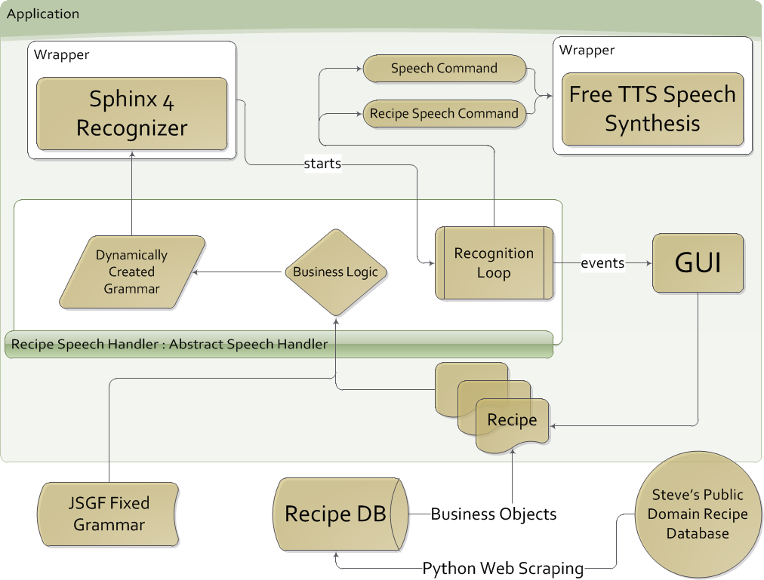

Slide 4
Challenges
Scraping
Minor details: Conversion .3333 →1/3 →”one third”
Easily pluggable components
GUI ←→ VUI interaction
Multithreading
Working with Sphinx (Especially when considering Multithreading)
Database schema design

Slide 5
TODOs
Speech interaction when selecting recipes
Better recipe scraping (never ends)
Better TTS (AT&T Mashups?)
Better Grammar
Unit conversions
Adding new recipes
Better Speech Recognition (???)
Fixing that annoying threading issue!
Nicer installer
Social Features
Recipe Favorites/User learning and adaptation
Serving slider
Cost estimator

